Slide 1
FPSE FEC
Ethics and the Faculty Ethics Committee
J Brian Pickering
IT Innovation, ECS
University of Southampton
Chair, FPSE FEC
http://blog.soton.ac.uk/fpseethics/
Version 8
Updated February 2017

Slide 2


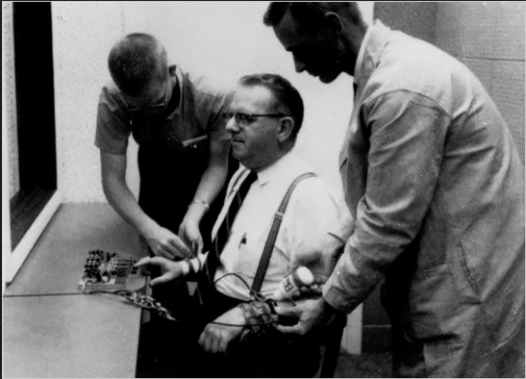
Ethics Committee remit
The University requires the ethical consideration of all research which involves human participants, human tissue, human data, or animals
Researchers and investigators submit research proposals for review and approval
Faculty Ethics Committees undertake review and approval of proposed research
Research:
An activity designed to investigate a conjecture, permit conclusions to be drawn, and thereby to develop or contribute to generalizable knowledge¹.
A study involves "research" if there is an intention to investigate an issue and to publish findings likely to be accessible to anyone interested.
¹ The Belmont Report: Ethical Principles and Guidelines for the protection of human subjects of research. Developed by The National Commission for the Protection of Human Subjects of Biomedical and Behavioral Research, April 18, 1979.

Slide 3
Experimental Research
Laboratory experiments
Field experiments
Focus groups
Interviews
Surveys
Online
Paper-based
TREATMENT OF PARTICIPANTS
PARTICIPANT PRIVACY
PARTICIPANT DATA
EXEMPTIONS FOR RESEARCH
HOW? The ERGO process
WHAT? What type of study?
Health & Safety
Data Protection
Copyright

Slide 4



Why seek ethics approval?
Key reasons to seek ethics approval:
Policy at the University of Southampton
Legal requirements of the Data Protection Act
Intrinsic concern for the human ‘Good’
Public relations and the ‘Kite Mark’
Insurance cover
Professionalism and appropriate behaviour
Funders and their requirements
Journal & other editorial policies
Oh, and there is one more…
Failure to obtain ethics approval or to follow approval conditions may constitute:
“Major breach of Academic Integrity” (student) or
“Misconduct” (staff)

Slide 5

Treatment of participants
Concern for the human good mainly involves the treatment of participants
The Ethics Committee review considers these major aspects:
Full disclosure of all relevant information
Fully informed consent
Protection of privacy
Appropriate inducement, if any, to participate
Negligible risk of harm
Minimally intrusive
Not deceptive
No coercion / inability to withdraw at any time for any reason
Not invasive

Slide 6

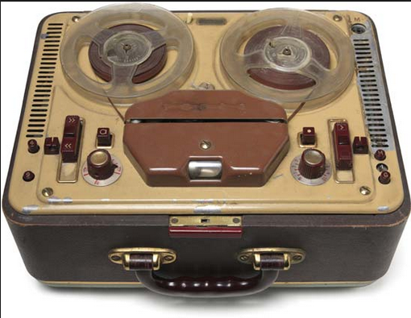
Participant privacy
Data Protection Act (DPA) 1998
Can any individual be identified from the data?
If not, privacy is not an issue
If so, steps must be taken to protect the data:
Export from the EU is controlled
Held securely (This usually involves some form of anonymisation where the bulk of the data is held separately from securely held names, addresses, and/or e-mails)
Normally, the DPA also requires:
Data retained for a limited period, then destroyed
Right of access to their data to be given to participants
Data not used or divulged apart from the agreed purpose of the study
Researchers have qualified exemption from these latter three requirements
Notes:
https://humane2020.eu/2016/12/15/gdpr-the-right-to-be-forgotten/
https://humane2020.eu/2017/01/24/cyberbullying-no-place-to-hide/

Slide 7


Participant data
‘Sensitive’ personal data of identifiable individuals usually only processable by authorised government agencies (police, health and social services, etc):
racial or ethnic origin
political opinions
religious beliefs
trade union membership
physical or mental health
sexual life
commission of offences or alleged offences
May be processed if explicit consent given
May be processed if it is in the public domain as a result of steps deliberately taken by the data subject
Secondary Data
commission of offences or alleged offences
Notes:
https://humane2020.eu/2016/12/20/sensitive-data-cognitive-resource-and-my-community-extending-the-tie-strength-dimension/

Slide 8
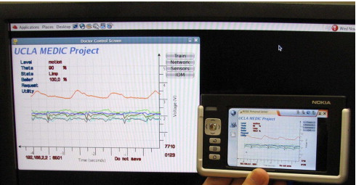

Exemptions for research
DPA exemptions for researchers:
Personal data can be processed for purposes other than those for which they were originally obtained
Personal data can be held indefinitely
A data subject has no right of access to their personal data provided the data is processed for research purposes and the results do not identify data subjects
Sensitive personal data can be processed provided such data are not used to take decisions about any person without their consent and no substantial damage or distress is caused to any person by the keeping of those data
However, the Data Protection principles still generally apply, notably the requirements to keep data secure and to control the export of data
Notes:
http://www.sciencedirect.com/science/article/pii/S0933365707001510

Slide 9
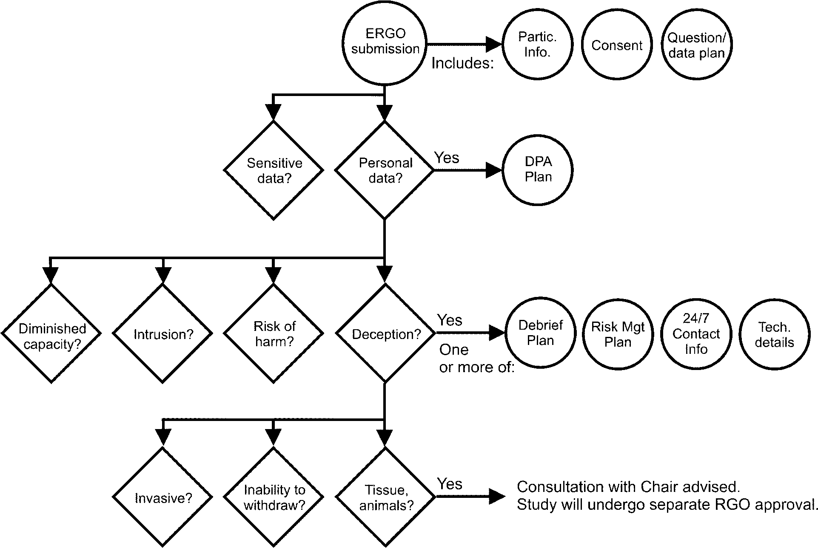
Application form major questions

Slide 10

Documentation required
Only needed if “Yes” at this point…

Slide 11

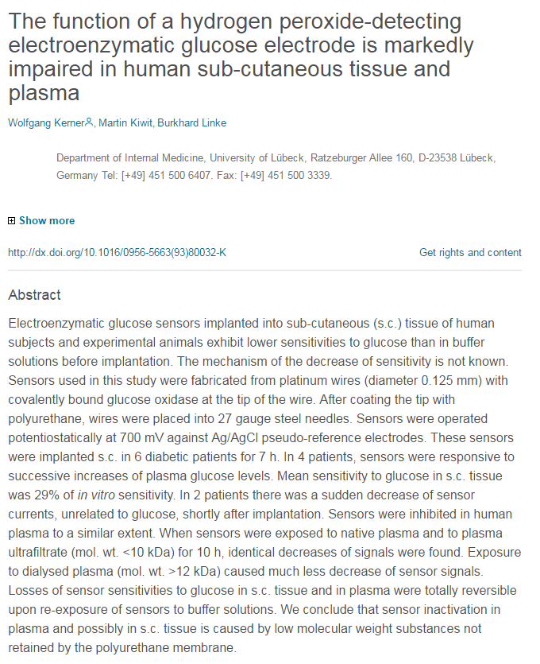
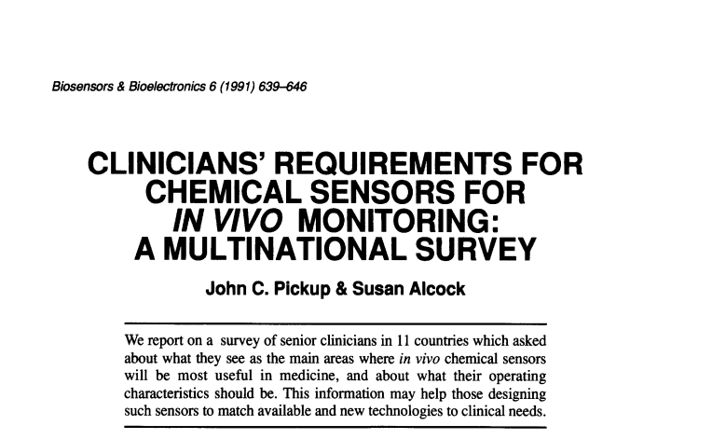
WHAT NEEDS APPROVAL?

Slide 12
To receive approval
Download the most current forms and instructions from ERGO (these change from time to time; do not rely on old copies)
Application form & helpful documentation (Instructions, Guide, Templates)
Complete the application form
Submit application on-line well before research start date
Upload submission (incl. participant information, consent, questionnaire, DPA plan)
Answer ERGO & IRGA questions to establish the research ‘category’ (and to provide information to the University about research activities)
If you are a student, your application is first reviewed by your supervisor before being passed on to the EC
Review may (probably will!) ask for change and resubmission
Retrospective approval not available
AND DON’T FORGET NRES

Slide 13
After approval
Insurance and legal cover provided by University’s RGO (Research Governance Office)
Reference number (ERGO/FPSE/xxxx) must be prominently shown on invitations to participate, advertisements, information forms, consent forms, questionnaires, etc
Material changes to, or adverse outcomes during, the study must be notified
A ‘material change’ is one where an answer to an application form question changes from “No” to “Yes”

Slide 14
Summary
Ethics approval required if the study involves humans or their data
Retrospective approval not available
The ethical issue is the treatment of the participants, ensuring
Full disclosure,
Informed consent, and
Protection of privacy (DPA)
Really good reasons will be required for intrusion, risk of harm, or deception.
Studies involving invasive techniques, lack of informed consent, coercion, restrictions on ability to withdraw, or ‘sensitive’ data may need approval from specialist FECs
ERGO reference number prominent on all communications

Slide 15



Thank you!
Sites: https://www.ergo.soton.ac.uk http://blog.soton.ac.uk/fpseethics/

